Slide 1
Introduction To Computer
The quick brown fox jumps over the lazy dog. The quick brown fox jumps over the lazy dog. The quick brown fox jumps over the lazy dog. The quick brown fox jumps over the lazy dog. The quick brown fox jumps over the lazy dog.
The quick brown fox jumps over the lazy dog. The quick brown fox jumps over the lazy dog.

Slide 2
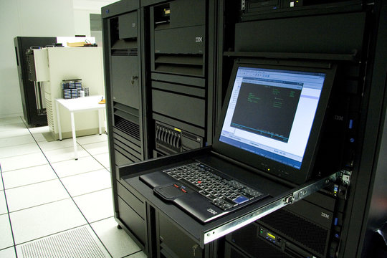
Types Of Computer
Anolog Computer
Watch, Speedometer, Thermometer
Digital Computer
Micro Computer
Mini Computer
MainFrame Computer
Super Computer

Slide 3
Diffrence Between RAM and ROM
RAM
ROM
The quick brown fox jumps over the lazy dog. don quick brown
Fox jumps over the lazy don. The quick brown fox jumps over the lazy dog.
The quick brown fox jumps over the lazy dog. The quick brown fox jumps over the lazy dog.
The quick brown fox jumps over the lazy dog. The quick
Brown fox jumps over the lazy dog. The quick brown fox jumps over the lazy dog.
The quick brown fox jumps over the lazy dog. The quick brown fox jumps over the lazy dog.

Slide 4
Conclusion
The quick brown fox jumps over the lazy dog. The quick brown fox jumps over the lazy dog. The quick brown fox jumps over the lazy dog. The quick brown fox jumps over the lazy dog. The quick brown fox jumps over the lazy dog.
The quick brown fox jumps over the lazy dog. The quick brown fox jumps over the lazy dog. The quick brown fox jumps over the lazy dog. The quick brown fox jumps over the lazy dog. The quick brown fox jumps over the lazy dog.
The quick brown fox jumps over the lazy dog. The quick brown fox jumps over the lazy dog. The quick brown fox jumps over the lazy dog. The quick brown fox jumps over the lazy dog. The quick brown fox jumps over the lazy dog.

Slide 5

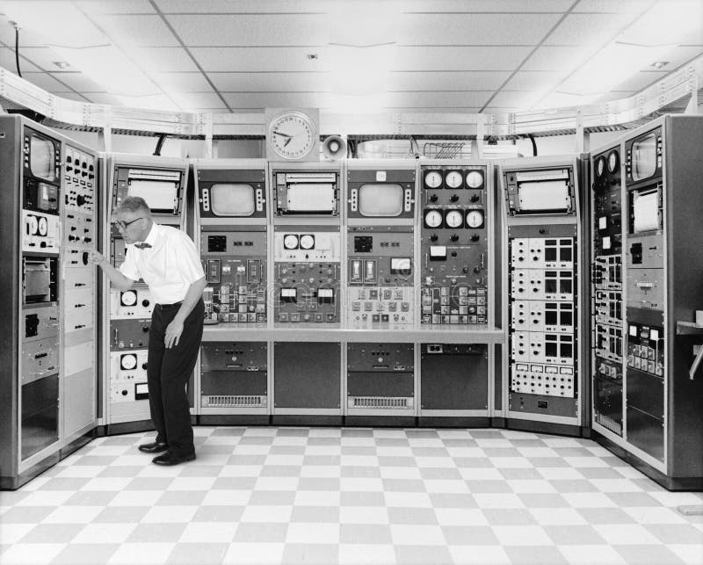
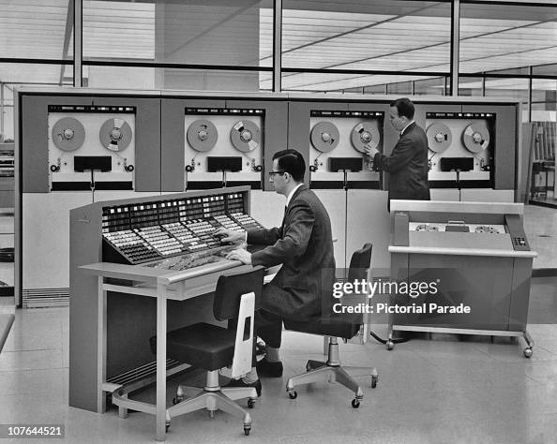

Slide 6
